Slide 1
Portfolio Analysis and Optimization
Presented by Dibya and Sahil
Bachelor of science (honours) in data science and artificial intelligence
Indian institute of technology Guwahati, India

Slide 2
Agenda
Introduction
Problem Context & Objectives
Dataset and Preprocessing
Methodology and Portfolio Optimization
Results and Analysis
Discussion
Conclusion & Future Scope

Slide 3
Introduction
Portfolio optimization is a fundamental aspect of investment management, focused on combining assets in a manner that maximizes expected returns while effectively controlling risk. Achieving this balance requires careful analysis of historical financial data and strategic capital allocation to mitigate the impact of market volatility. Modern portfolio theory (MPT) provides a quantitative framework for constructing diversified portfolios along the efficient frontier, enabling investors to understand the trade-off between risk and return and make informed investment decisions.

Slide 4
Problem Context and Objectives
Problem Context
Portfolio selection involves allocating capital across multiple assets under uncertainty
Investors face a fundamental trade-off between expected return and risk
Lack of proper diversification can result in inefficient and unstable portfolios
Objectives
Analyze historical risk and return characteristics of selected stocks
Evaluate diversification through correlation analysis
Construct optimal portfolios using Modern Portfolio Theory

Slide 5
Dataset and Preprocessing
Dataset
Daily adjusted closing prices of 5 selected Indian equity stocks (e.g HCLTech, Axis Bank, etc
Benchmark index: NIFTY 50
Time period: last 5 years of historical data
Data source: Yahoo Finance
Preprocessing
Missing values handled using forward-fill method
Daily logarithmic returns computed from price data
Returns and covariance matrix annualized assuming 252 trading days
Outliers checked to ensure data consistency

Slide 6
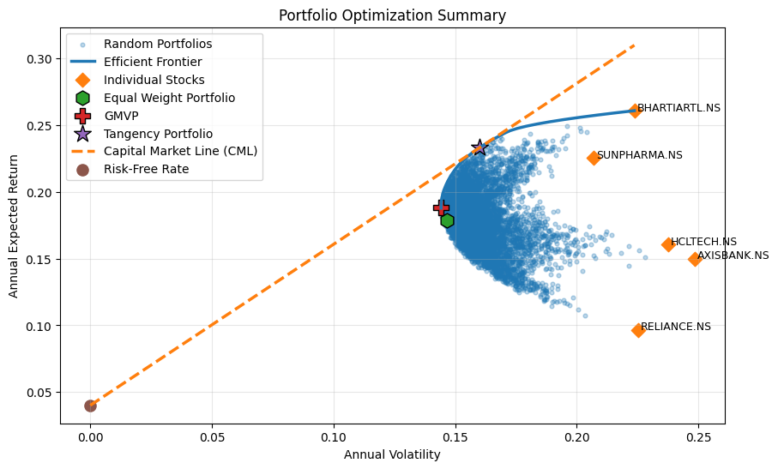
Methodology and Portfolio Optimization
Return and Risk Estimation
Expected returns computed from historical log returns
Risk measured using the variance–covariance matrix of returns
Portfolio Optimization
Global Minimum Variance Portfolio (GMVP) to minimize overall risk
Tangency Portfolio to maximize risk-adjusted return (Sharpe Ratio)
Constraints
Portfolio weights sum to one
No short-selling allowed

Slide 7
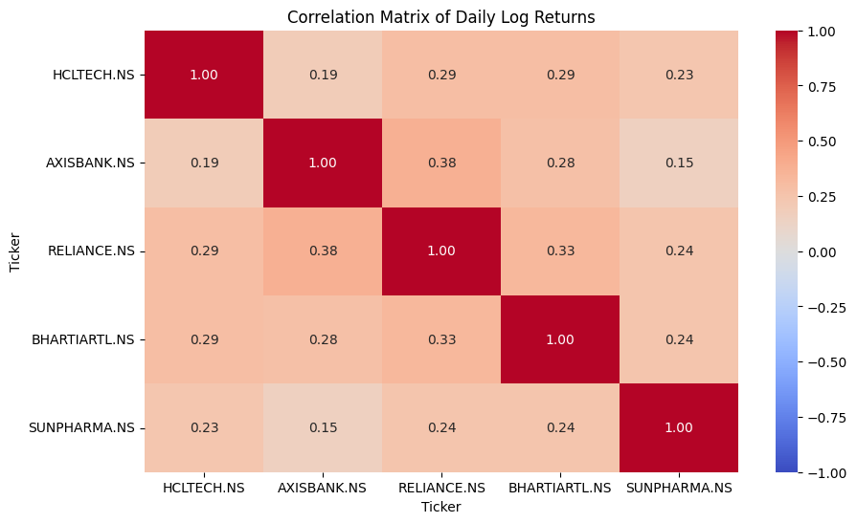
Results and Performance Analysis
Correlation analysis indicates diversification benefits among selected assets
Efficient frontier illustrates optimal risk–return trade-offs
Optimized portfolios outperform equal-weight and benchmark portfolios in risk-adjusted terms
Tangency portfolio achieves the highest Sharpe ratio

Slide 8
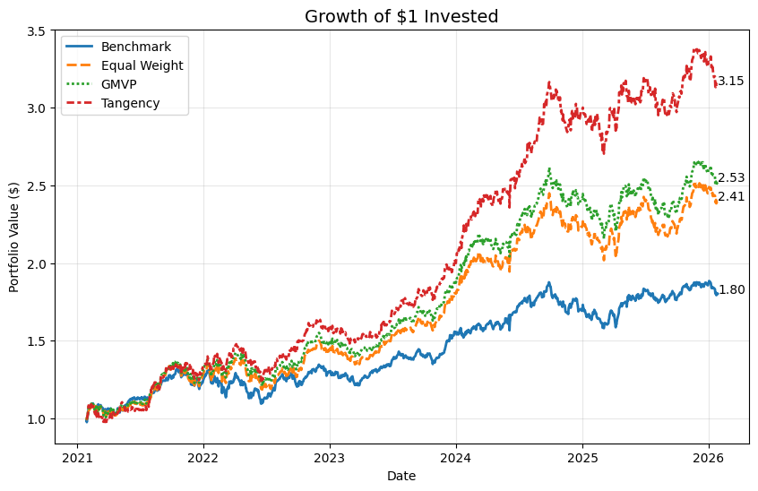
Discussion and Key Insights
Diversification significantly reduces portfolio risk without proportionally reducing returns
Global Minimum Variance Portfolio is suitable for risk-averse investors
Tangency portfolio provides superior risk-adjusted returns for return-seeking investors
Portfolio performance is influenced by historical data and underlying assumptions

Slide 9
Portfolio Weights Allocation Tables
Equal Weight Portfolio
Global Minimum Variance Portfolio
Ticker | Weight | Allocation (%)
HCLTECH.NS | 0.2 | 20.0
AXISBANK.NS | 0.2 | 20.0
RELIANCE.NS | 0.2 | 20.0
BHARTIARTL.NS | 0.2 | 20.0
SUNPHARMA.NS | 0.2 | 20.0
Ticker | Weight | Allocation (%)
SUNPHARMA.NS | 0.3170 | 31.7030
BHARTIARTL.NS | 0.1888 | 18.8766
HCLTECH.NS | 0.1761 | 17.6130
AXISBANK.NS | 0.1638 | 16.3821
RELIANCE.NS | 0.1543 | 15.4253
Tangency Portfolio (Maximum Sharpe Ratio)
Summary (Equal Weight Portfolio)
Ticker | Weight | Allocation (%)
BHARTIARTL.NS | 0.4529 | 45.2871
SUNPHARMA.NS | 0.4287 | 42.8724
HCLTECH.NS | 0.0603 | 6.0299
AXISBANK.NS | 0.0581 | 5.8105
RELIANCE.NS | 0.0000 | 0.0000
Return: 0.1788 | Volatility: 0.1466 | Sharpe Ratio: 0.9467
Summary (GMVP Portfolio)
Return: 0.1885 | Volatility: 0.1442 | Sharpe Ratio: 1.0303
Summary (Tangency Portfolio)
Return: 0.2333 | Volatility: 0.1601 | Sharpe Ratio: 1.2075

Slide 10
Tables Continued…
 | Expected Returns | Volatility (Risk) | Sharpe Ratio
Benchmark | 0.1199 | 0.1391 | 0.5746
Eq. Weight Portfolio | 0.1788 | 0.1466 | 0.9467
GMVP | 0.1885 | 0.1442 | 1.0303
Tangency Portfolio | 0.2333 | 0.1601 | 1.2075
Ticker | Beta | Expected Return
RELIANCE.NS | 1.1253 | 0.0965
AXISBANK.NS | 1.1026 | 0.1501
HCLTECH.NS | 0.8780 | 0.1607
BHARTIARTL.NS | 0.8344 | 0.2610
SUNPHARMA.NS | 0.5986 | 0.2256

Slide 11
Limitations and Future Work
Limitations
Analysis based on historical data and static assumptions
Transaction costs and taxes not considered
Portfolio weights assumed to be rebalanced instantaneously
Future Work
Incorporate transaction costs and realistic constraints
Extend analysis to a larger and more diverse asset universe
Explore dynamic and multi-period portfolio optimization models

Slide 12
Conclusion
Demonstrated practical application of Modern Portfolio Theory using real market data
Quantitative optimization improves portfolio risk–return efficiency
Optimized portfolios outperform naïve and benchmark-based strategies
The framework provides a systematic approach to informed investment decision-making

Slide 13
Thank you
Dibya & Sahil
https://github.com/m1ttal/Portfolio-Analysis-and-Optimization.git

